Slide 1


MedAi
Group Members:
Justinian Capone, Justin Sansbury,
Gabriel Jean-Jumeau, Xavier Figueroa,
Dexter Johnson, Thomas Driggers

Slide 2

We created MedAi a medical chatbot.
MedAi is aimed at providing insightful medical information and assistance to users.
Includes natural language processing (NLP).
MedAi can understand and respond to a wide range of medical queries efficiently.
This model would be great for diagnosing everyday household illnesses.
Project Overview

Slide 3

We used the “Comprehensive Medical Q&A Dataset” from Kaggle.
It provided us with over 43,000 real-life inquiries from a variety of situations.
Our Approach

Slide 4

Could Ai be used to better the field of medicine?
Can we create a model that can accurately diagnose ailments/injuries?
Can we create a model that can accurately display a diagnosis in a conversational statement?
Can we train the model to differentiate between diagnoses with similar symptoms?
Surfaced Questions

Slide 5

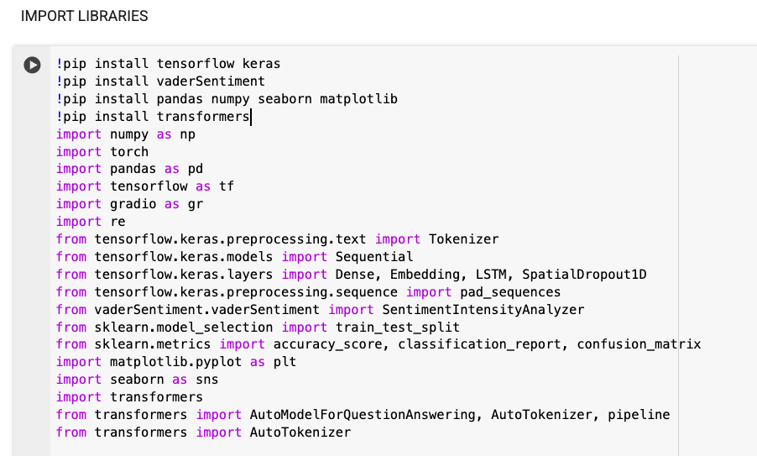
Libraries used from outside of class
Seaborn
Re
torch
Libraries used from class
See image on right —>
Libraries

Slide 6

Analyze data types missing values, unique values, and text data characteristics.
Outliers capped at the 95th percentile for answer length.
Average length was 50.68 characters.
Duplicates removed - duplicate rows.
Cleaning the Data

Slide 7

Loaded medical Q&A dataset into pandas dataframe.
Split the data into training and testing sets using the train_test_split from sklearn.
Converted the categorical type comments into numerical features which added 18 new columns to the dataframe.
Data Pre-processing

Slide 8

Imported all langchains dependencies.
Created a medical LLM using HuggingFace.
Used prompts, chains, and created a generator.
Ran into gradio.
Give model a prompt.
Created a format for answers.
Model Training and Testing

Slide 9
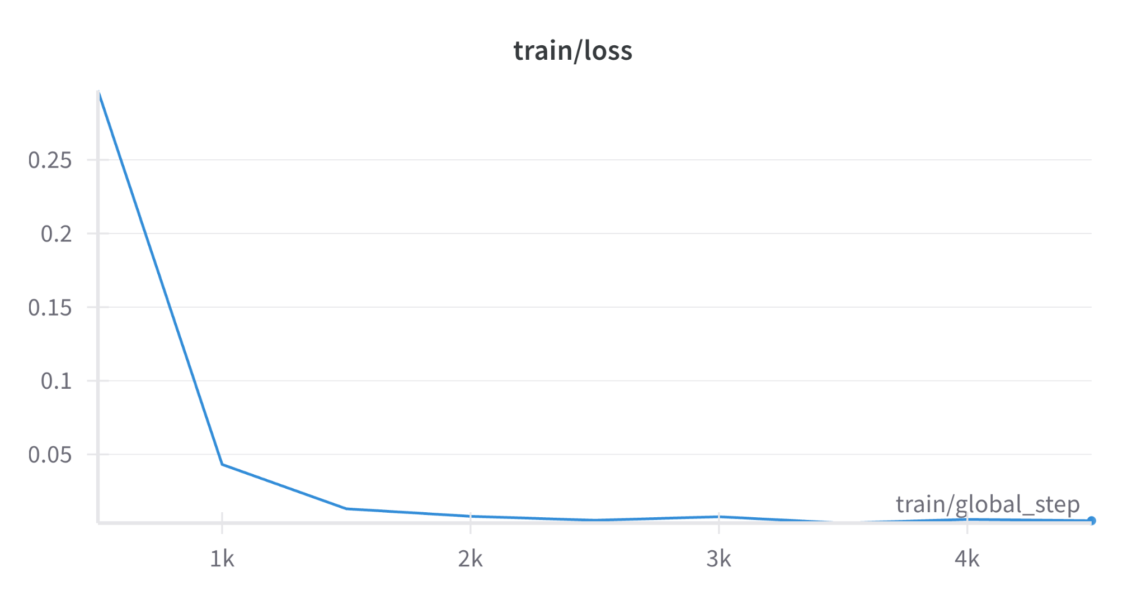
Initial Phase: The loss starts high and decreases rapidly, indicating effective learning during the early phase.
Stabilization: As training progresses, the loss decreases more slowly and begins to stabilize. This suggests that the model is converging to its optimal state.
Convergence: Toward the end of the training (around 3k to 4k steps), the loss remains fairly constant, indicating that further training may not significantly improve the model's performance.
Visualization

Slide 10
The learning rate schedule indicates a smooth transition from higher to lower values, which helps the model to initially learn rapidly and then fine-tune weights gradually.
By the end of the training (around 4k steps), the learning rate is quite low, helping the model to stabilize and converge more precisely.
Visualization

Slide 11
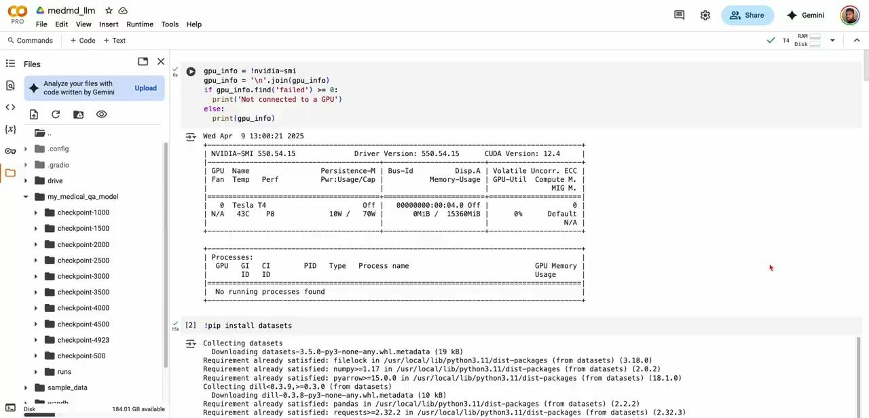
Demo and Slideshow

Slide 12
We found that the medical field can be improved by using an Ai interface.
Our model was able to accurately diagnose ailments/injuries in a text format.
We were able to train the model to differentiate between diagnoses with similar symptoms.
Final Summary

Slide 13

Using Ai LLM’s, HuggingFace, and RoBERTa, we were able to revolutionize medical data analysis in one week.
Ai will lead the charge into the future of medicine.
For future plans of enhancing MedAi’s capabilities we could implement image analysis using picture-to-text.
Conclusion

Slide 14

https://github.com/deondrae4088/WebMd_chat
Repository Links

Slide 15
Comprehensive Medical Q&A Dataset – Kaggle
Pandas Documentation
https://huggingface.co/deepset/roberta-base-squad2
References

